Slide 1
Capstone Project-3
Mobile Price Range Prediction
Supervised Machine Learning (Classification)
Robin Rego

Slide 2
Problem Statement:
Mobile phones have become a necessity for every individual nowadays. People want more features and best specifications in a phone and that too at cheaper prices.
Mobile phones come in all sorts of prices, features, specifications and all. Price estimation and prediction is an important part of consumer strategy. Deciding on the correct price of a product is very important for the market success of a product. A new product that has to be launched must have the correct price so that consumers find it appropriate to buy the product.
In the competitive mobile phone market companies want to understand sales data of mobile phones and factors which drive the prices. The objective is to find out some relation between features of a mobile phone (e.g.:- RAM, Internal Memory, etc) and its selling price. In this problem, we do not have to predict the actual price but a price range indicating how high the price is.
The main objective of this project is to build a model which will classify the price range of mobile phones based on the specifications of mobile phones.

Slide 3

Data Description:
Total Rows= 2000 Total features=21
Battery_power - Total energy a battery can store in one time measured in mAh.
Blue - Has bluetooth or not.
Clock_speed - speed at which microprocessor executes instructions.
Dual_sim - Has dual SIM support or not.
Fc - Front Camera mega pixels.
Four_g - Has 4G or not.
Int_memory - Internal Memory in Gigabytes.
M_dep - Mobile Depth in cm.
Mobile_wt - Weight of mobile phone.
N_cores - Number of cores of processor.
Pc - Primary Camera mega pixels.
Px_height and Px_width - Pixel Resolution Height and width.
Ram - Random Access Memory in Mega Bytes.
Sc_h and Sc_w - Screen Height and width of mobile in cm.
Talk_time - longest time that a single battery charge will last when you are.
Three_g - Has 3G or not.
Touch_screen - Has touch screen or not.
Wifi - Has wifi or not.
Price_range - This is the target variable with value of 0(low cost),1(medium cost),2(high cost) and3(very high cost).

Slide 4
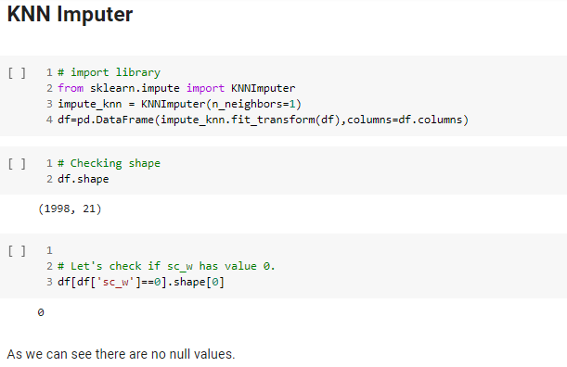
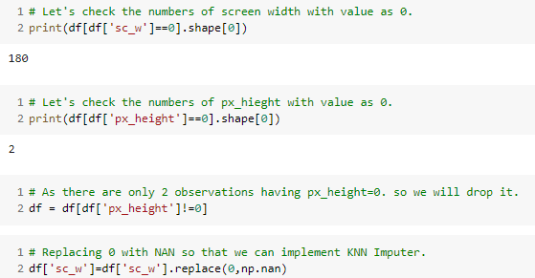
Data Wrangling :
NOTE: The minimum value of sc_width and px_height is 0. which is not possible in any mobile.
We need to handle this mismatch.
Therefore we use KNN Imputer
After handling the mismatched values we find the shape of the Dataset to be 1998 Rows and 21 Columns.
This is how we clean the dataset.

Slide 5
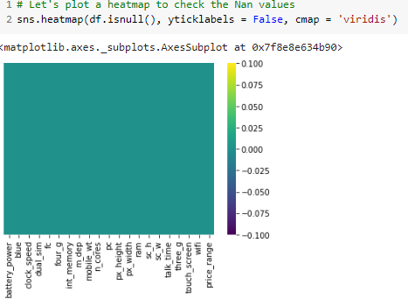
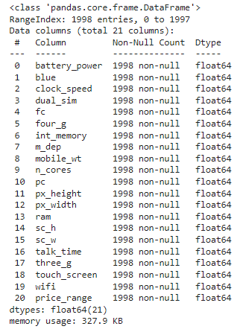

Data Wrangling :
Zero Missing values after handling mismatch from the data.
0 duplicates.

Slide 6
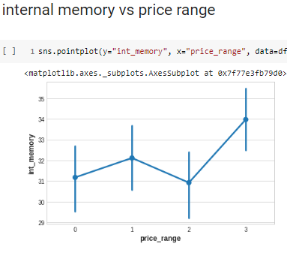
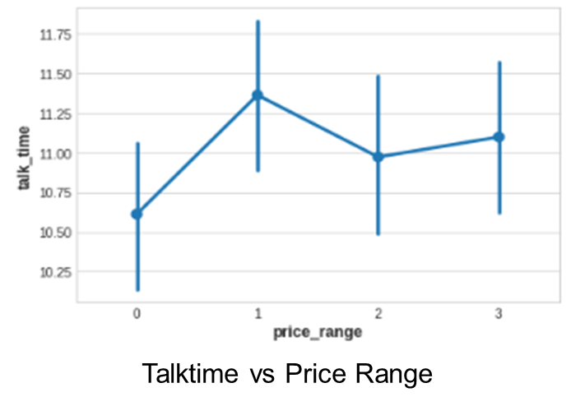
Exploratory Data Analysis (EDA) :
Internal memory vs Price Range

Slide 7
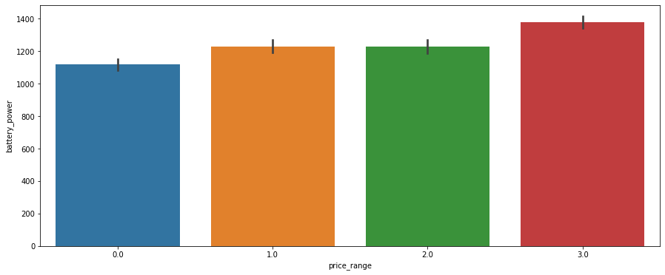
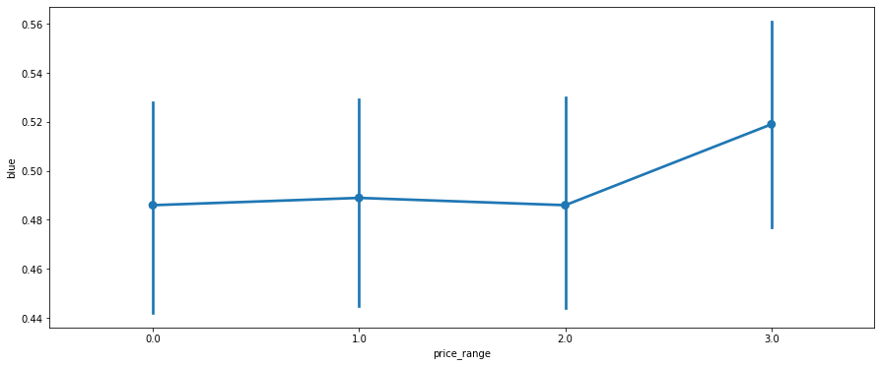
Exploratory Data Analysis (EDA):
So as we can see that as the battery power increases there is increase
in the price range of mobile.
NOTE: Mobiles of 1(medium cost) and 2(high cost) have almost the same battery power
Bluetooth vs Price_Range

Slide 8
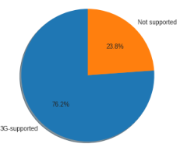
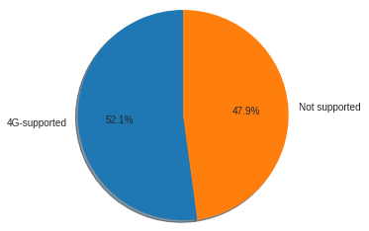
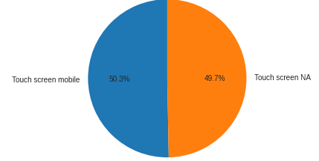
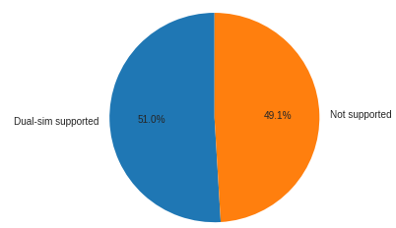
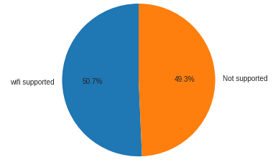
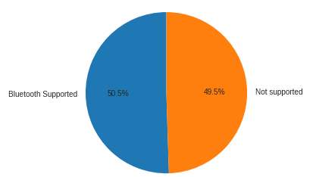
Exploratory Data Analysis (EDA):
Number of Phones which support 3G
Number of Phones which support 4G
Number of Phones which support Touchscreen
Number of Phones which support Bluetooth
Number of Phones which support Dual-Sim
Number of Phones which support wifi

Slide 9
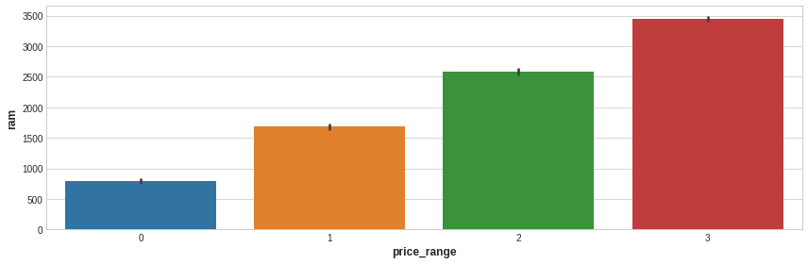

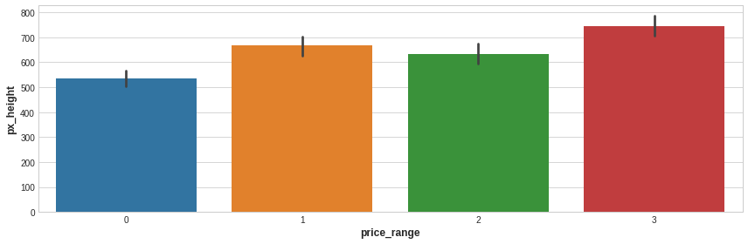
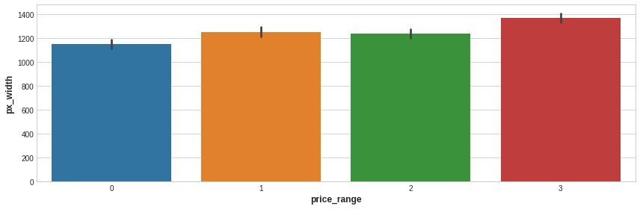
EDA (Exploratory Data Analysis):
Mobiles having RAM more than 3000MB falls under Very high cost category. As RAM increases price range also increases.
Mobiles having RAM less than 1000 MB falls under low cost category.
Mobiles with battery power more than 1300 mAh has very high cost. And Mobiles with battery power between 1200 and 1300 mAh falls under medium and high cost category.
Mobiles with more than 700 pixel height and width more than 1300 has very high cost.

Slide 10
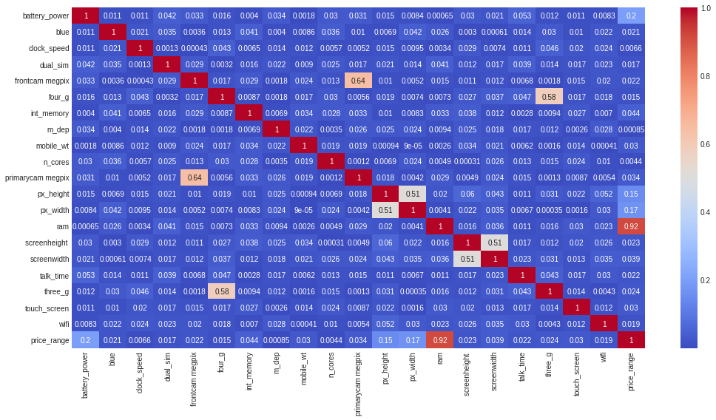
Exploratory Data Analysis (EDA) :
Correlation of independent variable with target variable.
RAM has strong positive correlation with the Price range and we know that Mobiles with high RAM are very costly. Thus RAM increases price range also increase.
Battery power also has positive correlation with the price range. Generally mobiles having high prices comes with good battery power.
Also px_height and px_width (Pixel Resolution Height and width) are positively correlated. Generally High price range mobiles have good resolutions.
Four_g and Three_g are highly positvely correlated. Nowdays most of the smart mobiles has both type of options. This could be the reason that they are correlated.
primary camera i.e pc and front camera fc are positively correlated.
sc_h and sc_w are positively correlated.

Slide 11
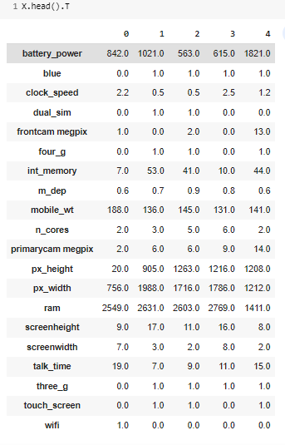
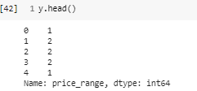
Distribution of Features :
We distributed the dataset into Dependent and Independent variable.
Independent Variables columns are as follows:
['dual_sim', 'three_g', 'touch_screen', 'm_dep', 'int_memory', 'sc_w', 'talk_time', 'wifi', 'px_height', 'n_cores', 'clock_speed', 'fc', 'ram', 'four_g', 'pc', 'battery_power', 'sc_h', 'blue', 'px_width', 'mobile_wt‘]
Dependent Variable column are as follows:
[price_range]
After distributing the Dependent and Independent variables, We are going to create a model using Train_Test_Split.
Price_range - This is the target variable with value of 0(low cost), 1(medium cost),2(high cost) and 3(very high cost).
Dependent Variables
Independent Variables

Slide 12
Model Selection and Evaluation :
Before building a models we performed the train test split. We kept 20% of the data for test and remaining 80% of the data for training the model.
We compared 6 algorithms and evaluated them based on the overall accuracy score and the recall of the
individual classes.
Accuracy is the ratio of the total number of correct predictions and the total number of predictions.
The recall is the measure of our model correctly identifying True Positives.
Decision Tree Classifier
Random Forest Classifier
Gradient Boosting Classifier
K-Nearest Neighbor (KNN) Classifier
XG Boost Classifier
Support Vector Machine (SVM) Classifier

Slide 13
Ways to analyze the model :
How do you analyze the performance of the prediction by the classification algorithm ?
Accuracy
Precision and Recall
Specificity
F1 Score
AUC - ROC

Slide 14
Result with the Model :
Best result obtained is by K-Nearest Neighbor (KNN) Classifier.
Followed by 1. Gradient Boosting Classifier, 2. XG Boost Classifier.
The worst performed algorithm is Support Vector Machine (SVM) Classifier.

Slide 15
Conclusions:
We Started with Data understanding, data wrangling, basic EDA where we found the relationships, trends between price range and other independent variables.
We selected the best features for predictive modeling by using KNN Imputer best feature selection.
Before building a models we performed the train test split. We kept 20% of the data for test and remaining 80% of the data for training the model.
Implemented various classification 6 algorithms, out of which the K-Nearest Neighbor (KNN) Classifier algorithm gave the best performance followed by 1. Gradient Boosting Classifier, 2. XG Boost Classifier.
The worst model performance was by Support Vector Machine (SVM) Classifier.
We checked for the feature importance's of each model. RAM, Battery Power, Px_height and px_width contributed the most while predicting the price range.

Slide 16


